Slide 1
Welcome to Game Dev

Slide 2
Announcements
Meet our Interns!
Farabi
Amir
Raj
*All intern applicants will still be eligible to apply for leadership next year

Slide 3
Steam Gift Exchange!
NO MEETING ON 12/7
Sign-up form on the discord!
Sign-up by Friday the 27th
Black Friday sale this weekend!
Give gifts by Monday the 30th
You must give a gift to get a gift
$15 spending limit
See you in the spring! Look forward to more guest speakers, workshops, game jams and more!

Slide 4
Inventory
Systems
10/26
UA Game Dev
Jonah Venglarcik

Slide 5
01. definitions
03. implementation
02. examples
04. conclusion
Important terminology
Tips for creating a simple inventory system
Examples of inventory systems in games
Summary and wrap-up

Slide 6
01.
definitions
Important terminology

Slide 7
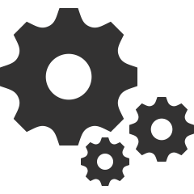


some basic definitions
inventory
system
item
slot
A full-featured solution to the problem of allowing players to retain, equip, and use “items”. Includes design, GUI, programming, audio, and visual elements.
An object of interest that the player should be able to retain in some fashion.
Examples: weapons, notes, keys, potions, consumables, etc.
A space in the player’s inventory designated for an item. This serves a different purpose depending on the style of system, but will likely be present in all systems in some capacity.

Slide 8



inventory attributes
weight
dimensions
stack size
The cost of holding an item. In some inventory systems, the player has a maximum total weight for the items they can hold.
The size and shape of an item. In some inventory systems, items can take up multiple slots or have some other behavior depending on these attributes.
The number of items that can be stored in a single slot. This number can be per-item or a global value for the entire inventory system.

Slide 9
02.
examples
Examples of inventory systems in games

Slide 10
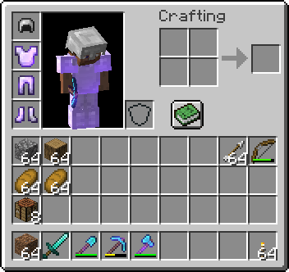
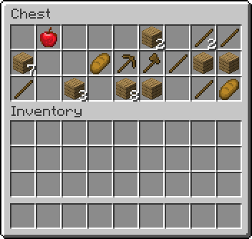
example: Minecraft
Sandbox, Survival (2011)
Simple stack-based grid
Limited to 27 slots + 9 slot hotbar
“Expandable” in a few ways
Storage blocks
Shulkers
Bundles
Layout is determined by the player
Limitations encourage creativity, ingenuity, and utilitarianism.

Slide 11
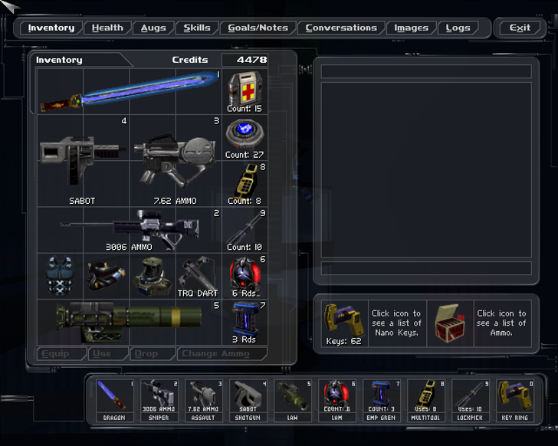
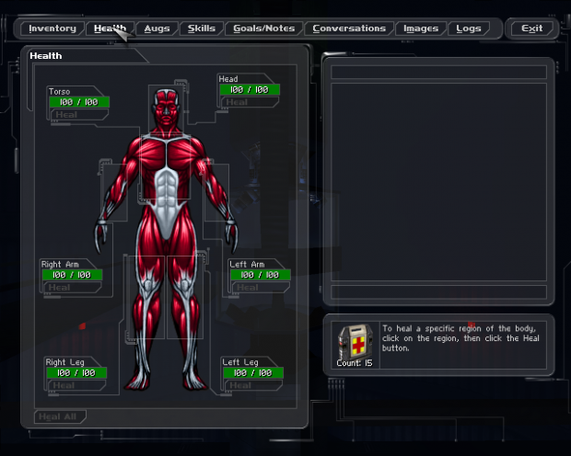
example: Deus Ex
Action RPG, First-Person Shooter, Stealth (2000)
Items have a size relative to your inventory slots
Generally, more powerful items are larger
“Essential” items take up valuable space
Hotbar is a visual stand-in for hotkeys/favorites
Unlimited space for keys and quest items
“Inventory Tetris” can be a mildly engaging activity within the GUI, and it encourages the player to optimize for their playstyle, since Deus Ex is very open-ended.
The sequels added different shapes of items and item rotation for increased depth.

Slide 12
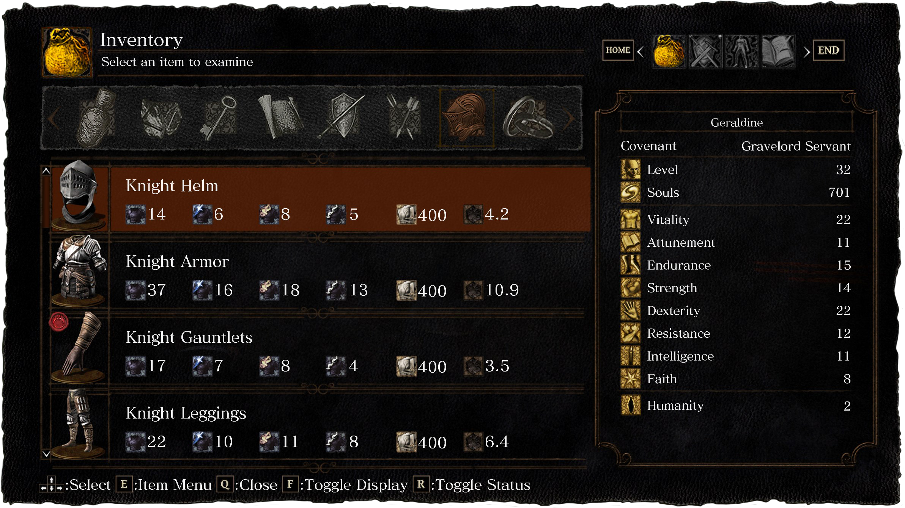
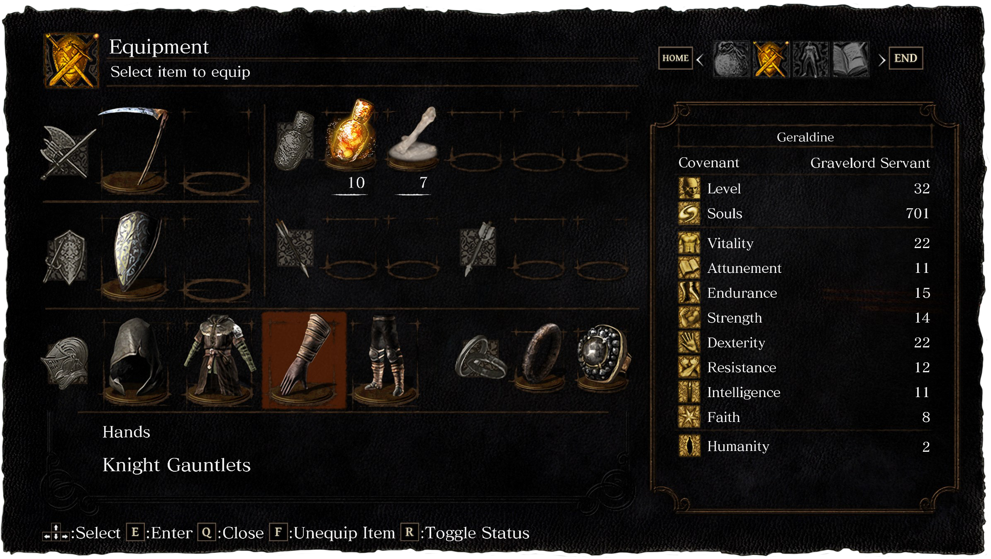
example: Dark Souls
Action RPG (2011)
Separate screens for browsing and equipping
Infinite inventory space
Item weight only applies to equipped items
Terse captions, no animations
Very detailed stat views are available
All important information in a glimpse
Unlimited storage promotes experimentation, and encourages the focus on min-maxing just your equipped items.
Pragmatic yet comprehensive interface design results in a high skill ceiling for character management.

Slide 13
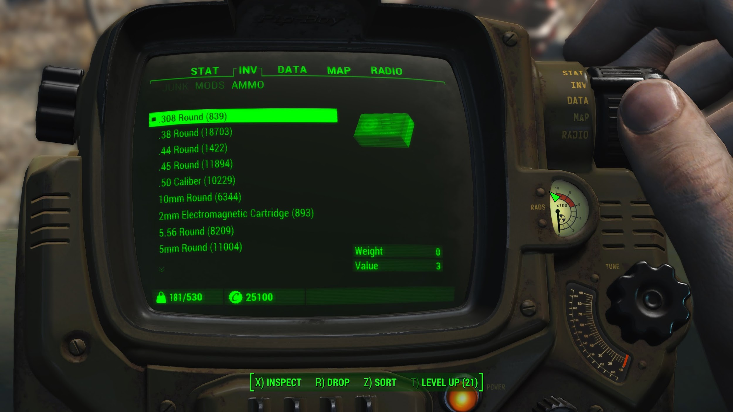
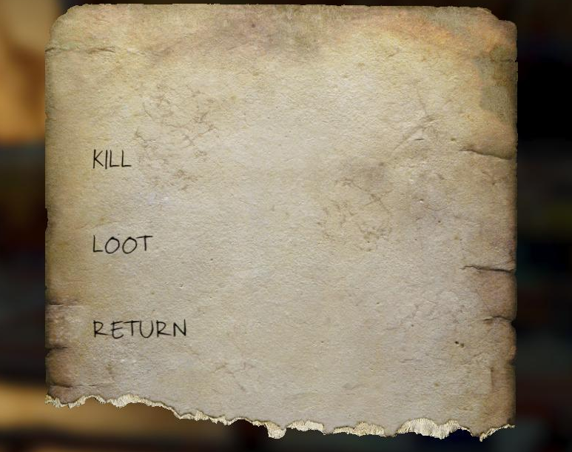
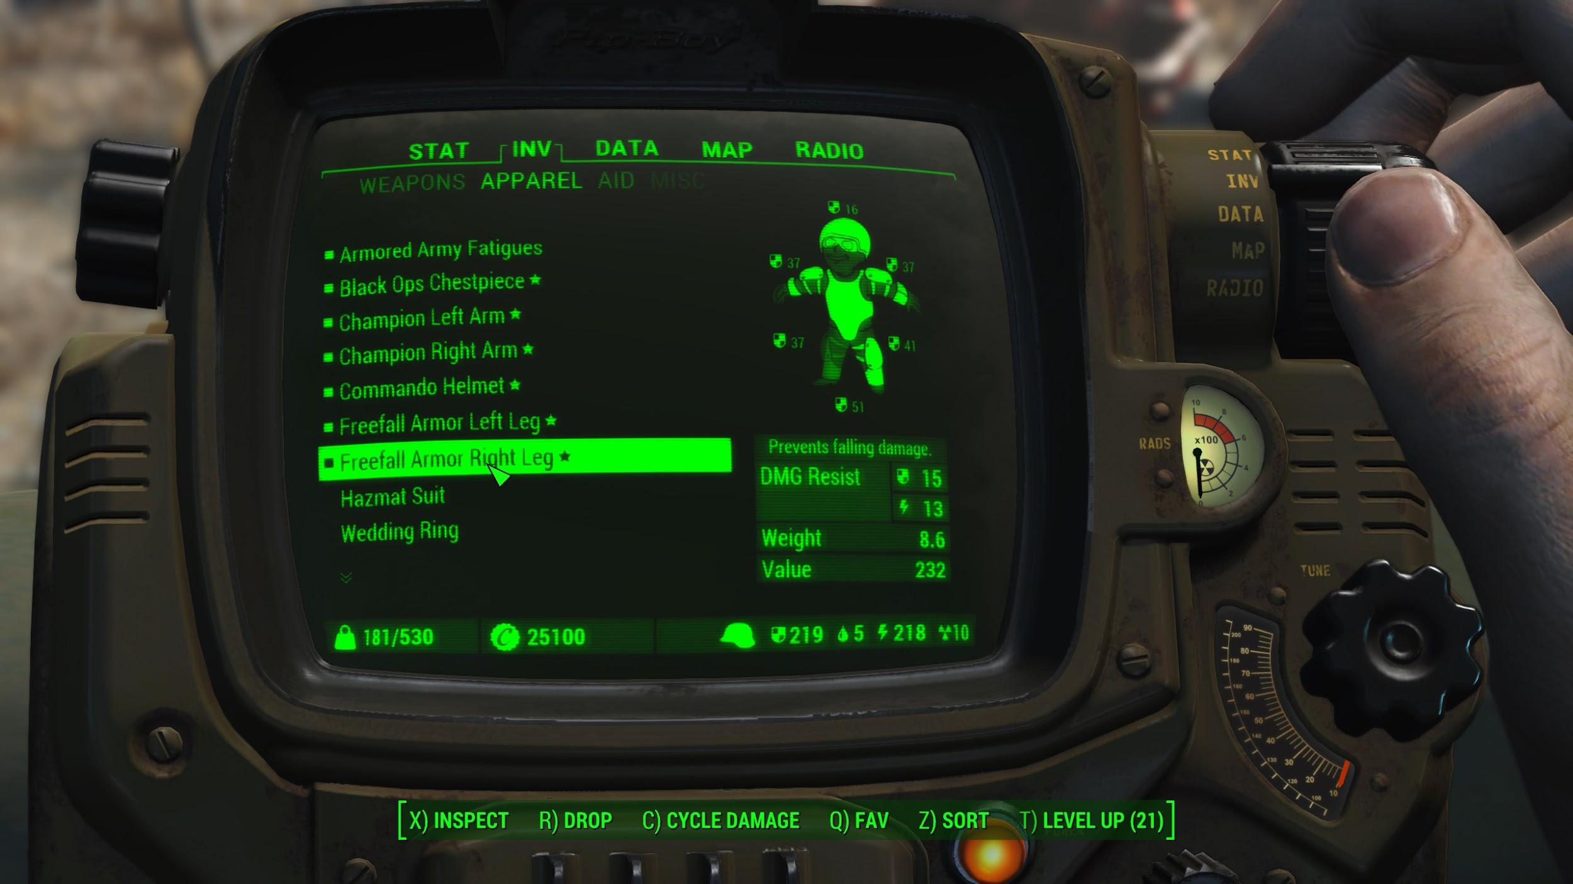
example: Fallout 4
Action RPG (2015)
Inventory presented diegetically on the Pip-Boy
Carry weight limit (en)forces gameplay loop
Kill
Loot
Return
Simple scrollable lists
Minimal stats shown to player anywhere
Fallout 4’s inventory system is designed to be immersive and simple. Along with the constant concern of your carry weight limit, everything services the brief and repetitive RPG-lite gameplay loop.

Slide 14
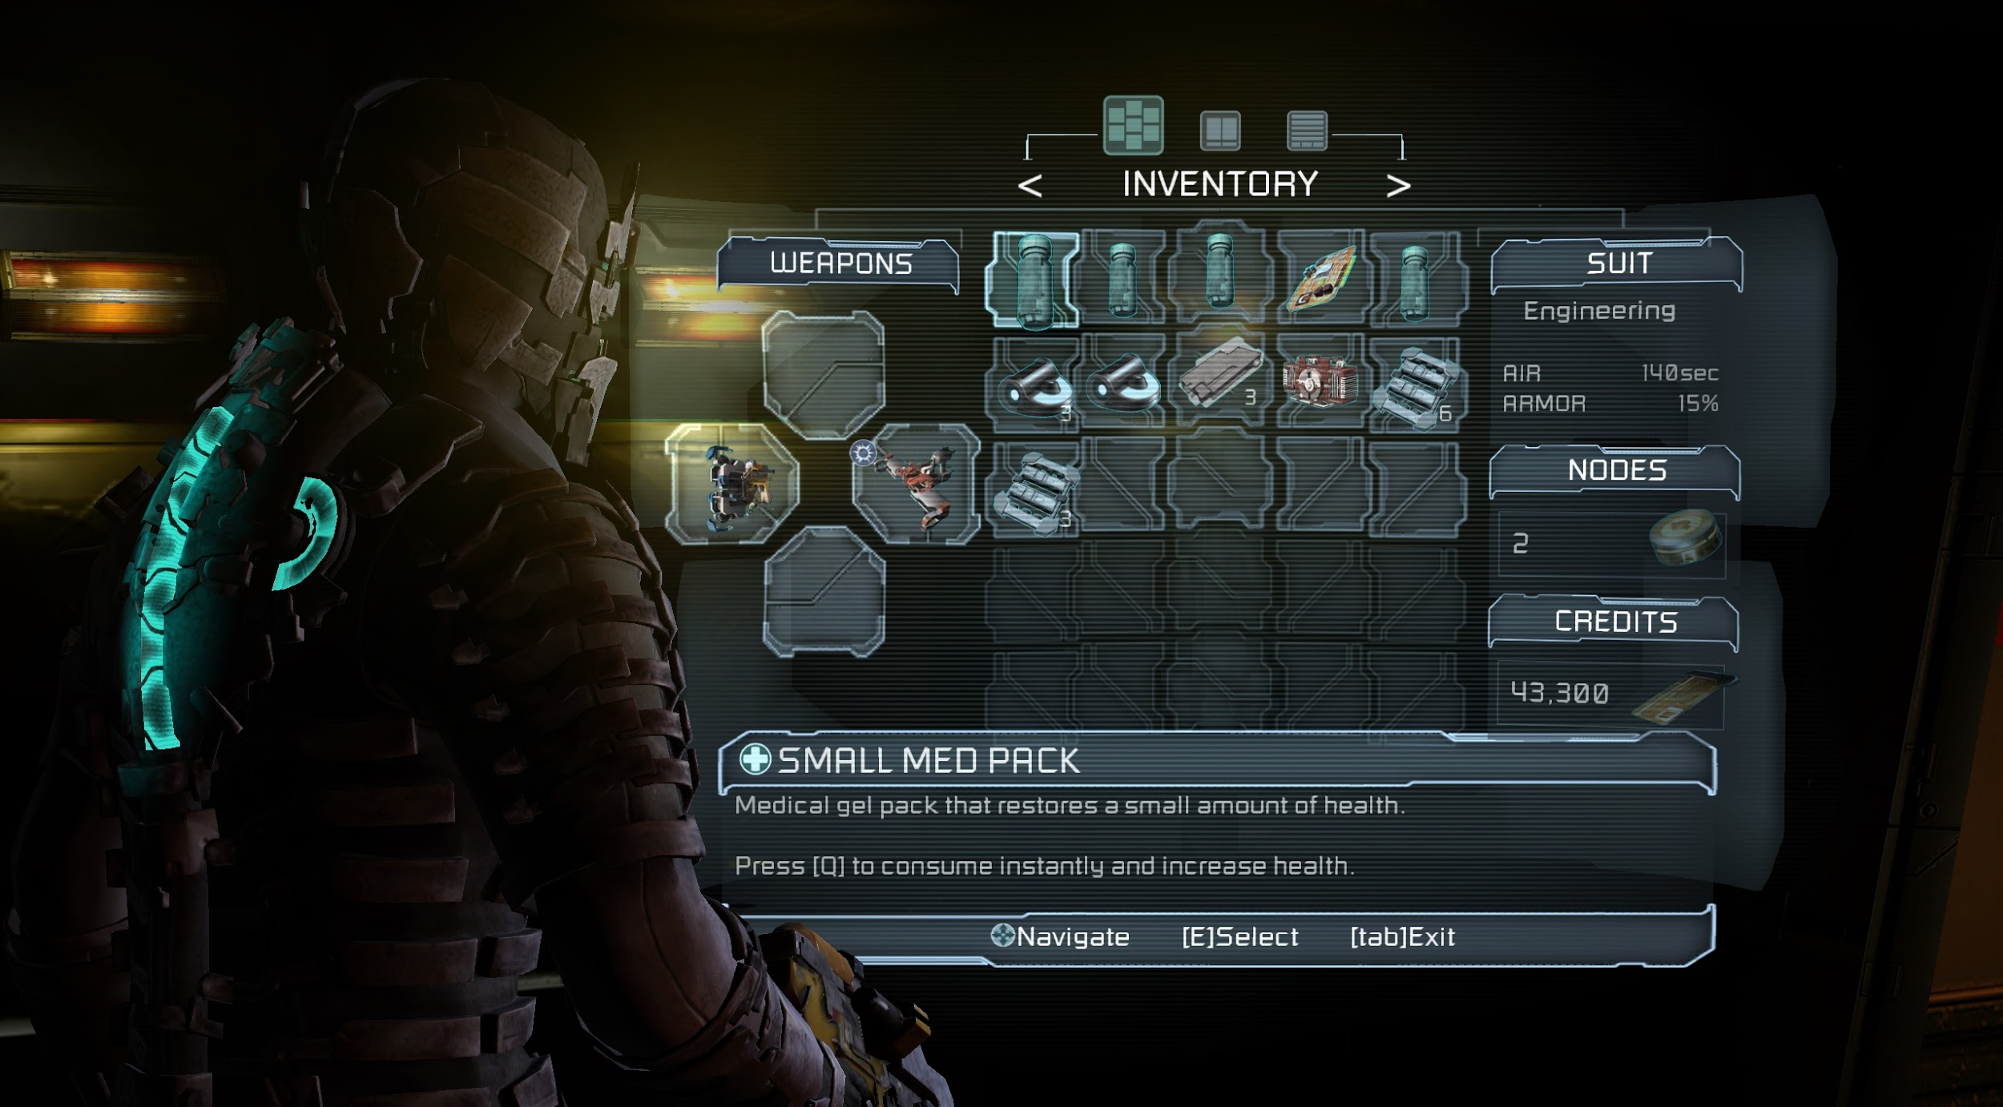
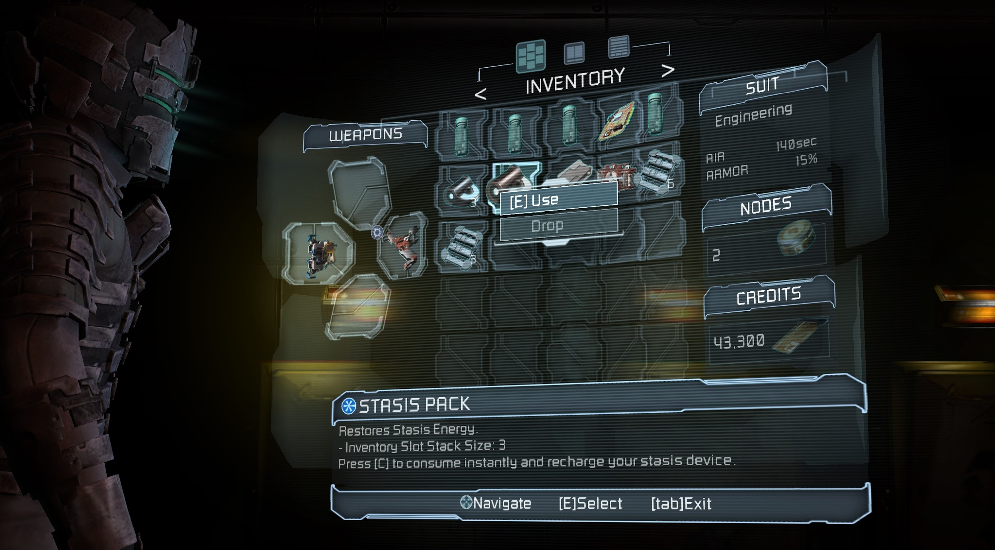
example: Dead Space 2
Survival Horror (2011)
Also presented diegetically in 3 dimensions
Provides summary of all important information
Limited slots increases tension
Most items don’t stack
Upgrade slot count with new suits
Can move while interacting with inventory
Limiting the resources your player can carry can make them more anxious. This is good in a horror game.
Horror games inherently become less scary as they go on, so a progression of inventory freedom merely follows this trend.

Slide 15
03.
implementation
Tips for creating a simple inventory system

Slide 16
create an Item class
Item.cs
public class Item : ScriptableObject {
public int id;
public string name;
public string description;
// optionally, make parameters for
// weight, dimensions, and stack size,
// depending on the style of your system
public virtual void UseItem()
{
}
}
We need a generic “Item” class that can represent any item in the inventory.
This class can be extended to represent specific types of items.
We will treat everything in the inventory as an Item.
ID is good for keeping track of a large number of items. We won’t use it here, but it’s nice to have for later.
Implement UseItem() in your subclasses to define the behavior of each item type.

Slide 17
create subclass(es)
Powerup.cs
[CreateAssetMenu (fileName = “new Powerup”, menuName = “Items/Powerup”)]
public class Powerup : Item {
public virtual void UseItem()
{
// powerup behavior
}
}
The CreateAssetMenu clause lets us create a new Powerup asset in the Unity Hierarchy.
UseItem() should be implemented for each type of item’s unique behavior.

Slide 18
create Inventory class
Inventory.cs
public class Inventory : MonoBehaviour {
public int maxSlots;
private Dictionary<Item, int> items =
new Dictionary<Item, int>();
public void AddItem(Item itemToAdd)
{
if items.ContainsKey(itemToAdd)
{
items[itemToAdd] += 1;
}
else if (items.Count >= maxSlots)
{
Debug.Log(“Inventory Full!”)
}
else
{
items.Add(itemToAdd, 1);
}
}
...
Our inventory as it stands here supports infinitely sized stacks of a limited number of items.
If the item is already in the inventory, we just add to the number of that item we’re carrying.
If the item being added isn’t in the inventory, but the inventory is full, we don’t add it.
If the item being added isn’t in the inventory, and there is room, we add it with a count of 1.

Slide 19
create Inventory class (cont.)
Inventory.cs (cont.)
...
public void UseItem(Item item)
{
if items.ContainsKey(item)
{
items[item] -= 1;
item.useItem();
if (items[item] == 0)
{
items.Remove(item);
}
}
else
{
Debug.Log(“Don’t have item!”)
}
}
}
To use an item, we check if our inventory contains the item, then reduces its count and uses it. If the count for the item becomes 0 as a result, we remove the item from the inventory.
If the inventory does not contain the item, we don’t use it.
Add getters & stuff so you can construct a GUI!

Slide 20
04.
conclusion
Summary and wrap-up

Slide 21
design with intent
Don’t be afraid to limit your player’s storage abilities
Think about what attributes you want to take into consideration
Item weight
Item shape/size
Stack size
More???
How does your inventory system affect the player experience?
Check out systems in other games
How do they make you feel?
How much information does the player need to know?

Slide 22
code snippets
Item.cs
Inventory.cs
public class Item : ScriptableObject {
public int id;
public string name;
public string description;
// optionally, make parameters for
// weight, dimensions, and stack size,
// depending on the style of your system
public virtual void UseItem()
{
}
}
public class Inventory : MonoBehaviour {
public int maxSlots;
private Dictionary<Item, int> items =
new Dictionary<Item, int>();
public void AddItem(Item itemToAdd)
{
if items.ContainsKey(itemToAdd)
{
items[itemToAdd] += 1;
}
else if (items.Count >= maxSlots)
{
Debug.Log(“Inventory Full!”)
}
else
{
items.Add(itemToAdd, 1);
}
}
public void UseItem(Item item)
{
if items.ContainsKey(item)
{
items[item] -= 1;
item.useItem();
if (items[item] == 0)
{
items.Remove(item);
}
}
else
{
Debug.Log(“Don’t have item!”)
}
}
}
Powerup.cs
[CreateAssetMenu (fileName = “new Powerup”, menuName = “Items/Powerup”)]
public class Powerup : Item {
public virtual void UseItem()
{
// powerup behavior
}
}

Slide 23
Thanks!
Any questions?

